Slide 1
Case study: The Yoruba Culture group
Traditional Religion in Africa

Slide 2
Indigenous African Religions: Nigeria
Yoruba Religion (southwest Nigeria)
Igbo Religion (Ibo) (south central Nigeria)
Kalabari Religion (Niger Delta)
Others….

Slide 3
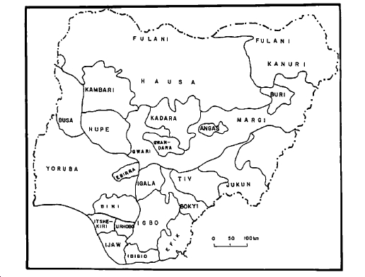
Notes:
Nigeria
locations dominated by particular ethnic groups, of historically known for the followjng ethnic groupings.

Slide 4
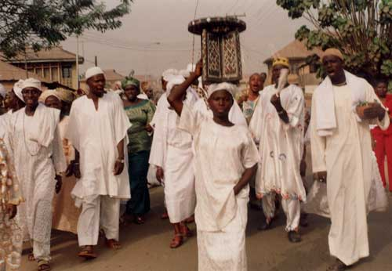
The Yoruba (southwest Nigeria)
2nd largest ethnic group, urbanized – divided according to class and wealth.
Built many kingdoms headed by an oba (king), ruled by a council of chiefs representing different lineages.

Slide 5
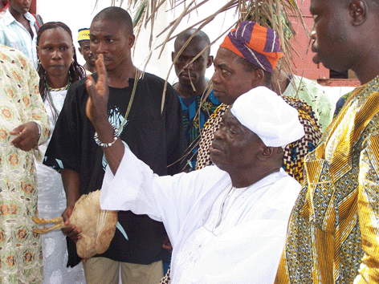
Yoruba Religion
believes in the power of kings and chiefs
political hierarchy intertwined with religious hierarchy
Olodumare – supreme God
Oduduwa-agent (16 princes > kingdoms)
Orisas- intermediary gods

Slide 6
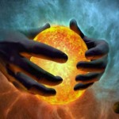
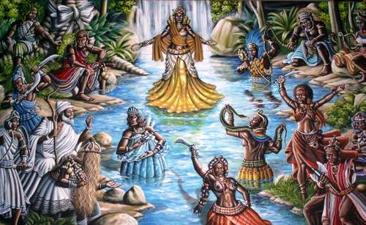
basis of belief
Orisas – intermediary spirits
nature and character
Halves of the calabash –Things must remain in balance

Slide 7
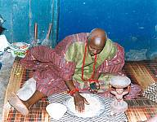
Individual consultations
Ifa- divination system,
Based on a large body of religious verses – odu
Religious, social, and
philosophical knowledge
Priest – the babalawo
Interprets the odu

Slide 8
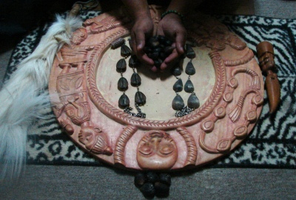
Ifa divination
To divine, the babalawo uses a set of objects that acquire meaning when an odu (verse) becomes associated with that person.
Ifa prescribes which god to honor, sacrifices to make, ceremonies to perform.

Slide 9
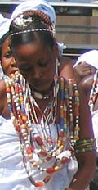
Spirit possession – mediums trained to embody the orisa
Bringing the world of spirits to human life
Go between two worlds
Festivals for orisas
orisa summoned - best suited for current problem in community life.

Slide 10
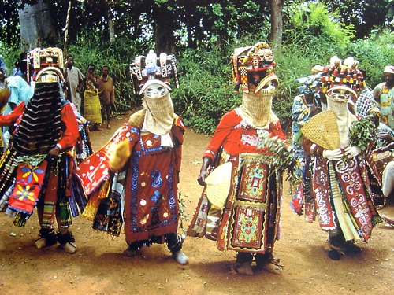
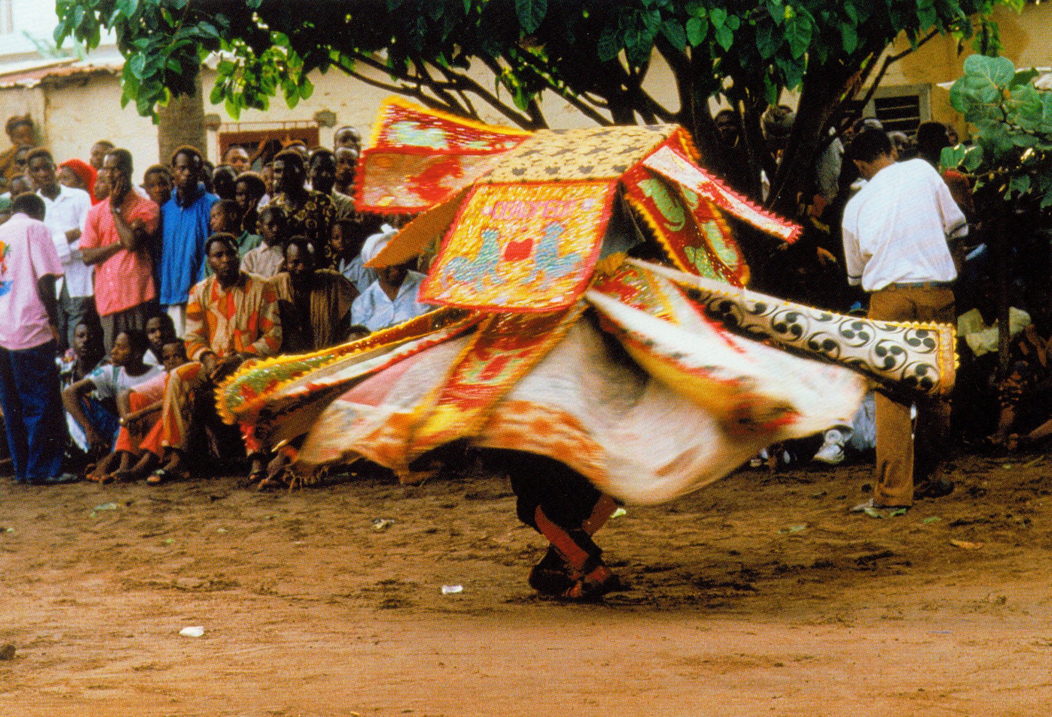
Yoruba masquerades – festivals or important ceremonies
Gelede Festival
EgungunDancer
Notes:
image at: naijaboi.tumblr.com/ post/3789051170/mymindspe...
image at: www.arthistory-archaeology.umd.edu/ ARTHwebsit...

Slide 11
Approach of Christian Missionaries during the pre-colonial and colonial era
Missionaries believed that Africans had no concept of religion or a supreme being.
Lacked knowledge of unique social logic and cultural values, practices were baffling.
Misunderstood the role of intermediary spirits and gods.

